Slide 1
WomenTechWomenYes (WTWY)
Street Team Placement Recommendations 2021
By Cheryl McGowan 9/17/2021

Slide 2
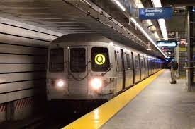
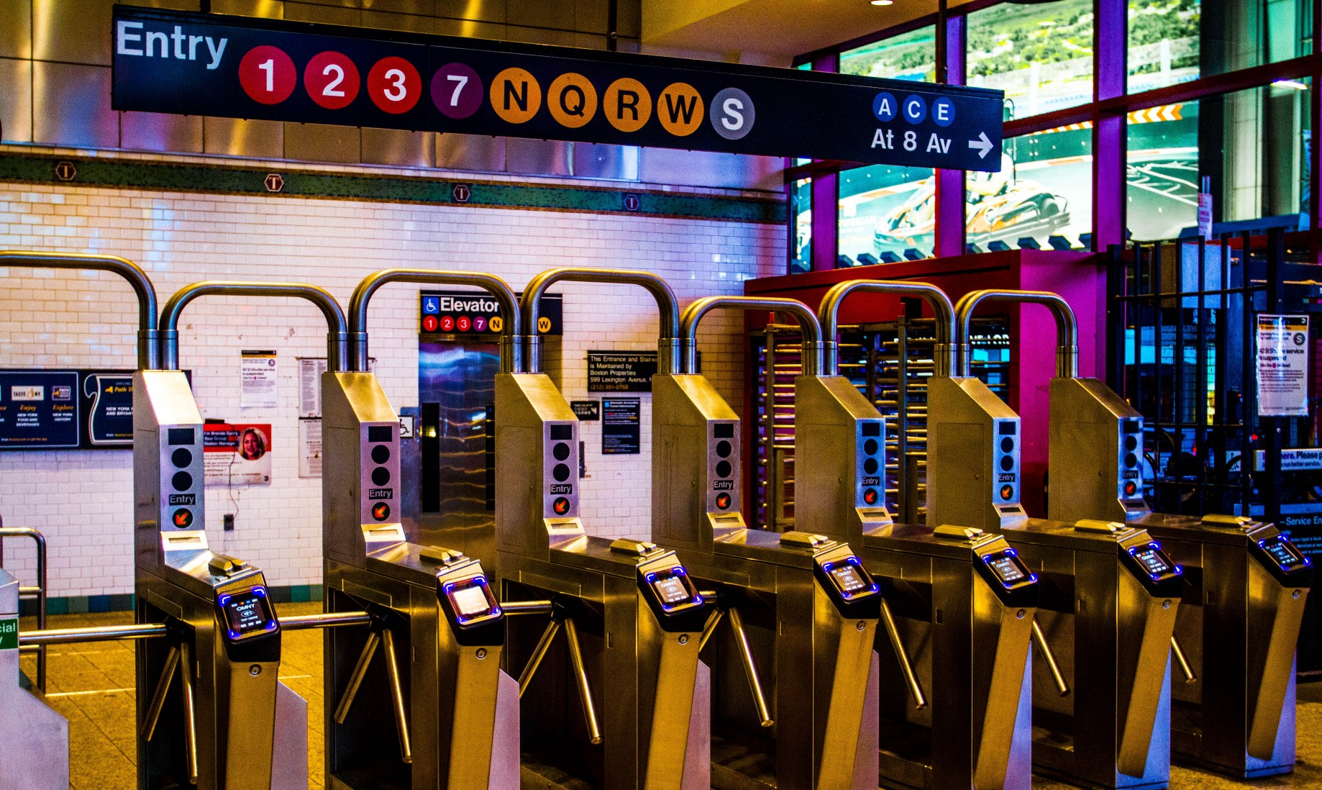
Project Goals
Provide recommendations on the best subway stations to place WTWY street teams at in order to gather email addresses of people interested in attending the annual gala and/or donating to the organization
Identify NYC area MTA subway stations with the most traffic
Compare those stations Big Tech companies and tech start ups to find additional stations where our target audience may be
Provide insight into the minimum, maximum and average number of volunteers needed to cover these stations
Photos by ABC7NY.com and Paula Silva on Unsplash

Slide 3
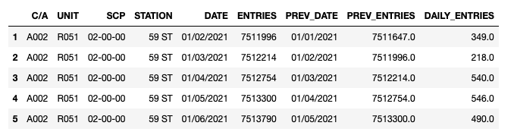
Data Sources and Tools
SQLAlchemy, Pandas and matplotlib were used to analyze, clean, filter, sort and visualize the data.
MTA public ally available data set on daily entries and exits from turnstiles
One feature that describes the data is cumulative daily entries per turnstile and station YTD 9/3/2021.

Slide 4
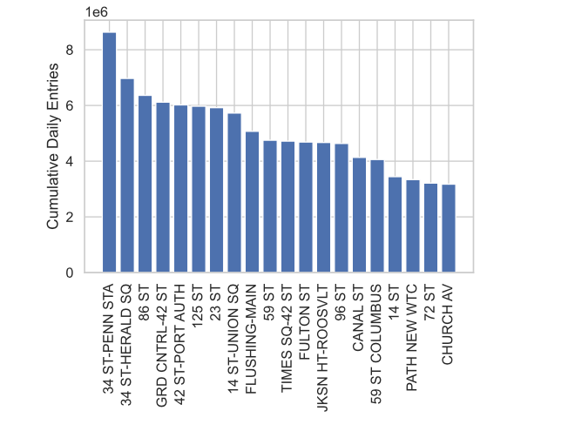
Station Traffic
Highest volume station is the 34th Street Penn Station.
Positioning volunteers at this station will be important to capturing people interested in supporting women in technology
Facebook leased office space at the post office complex next to Penn Station (1)

Slide 5
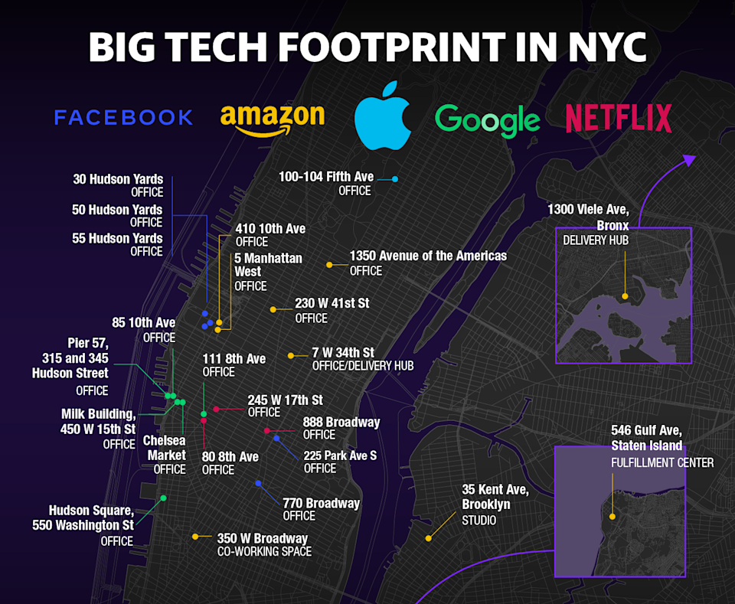
Big Tech Co Locations
Yahoo Finance article by Sarah Paynter and Krystal Hu from January 5, 2020:
Why America’s tech giants are flocking to one part of NYC
Shows a concentration of tech workers in Manhattan

Slide 6
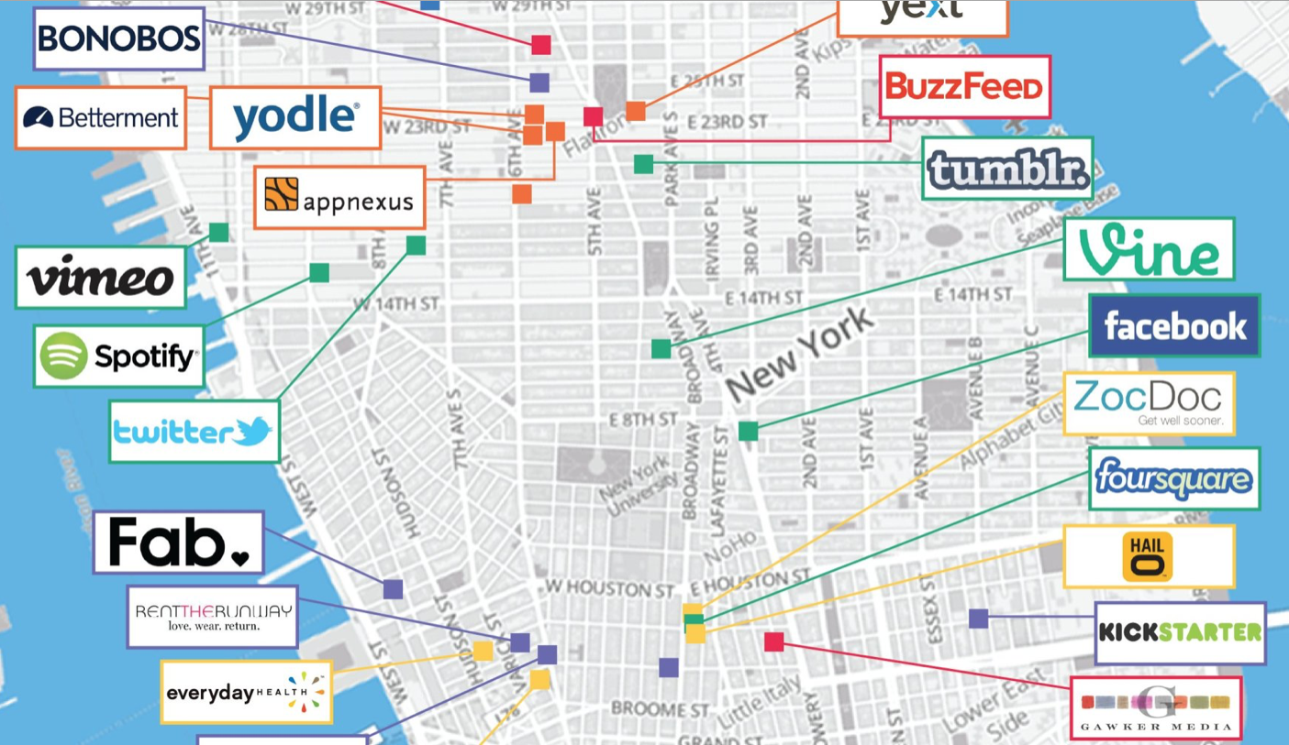
Tech Start Ups
FINSMES Article published Sep 5, 2018
The End of 2018 Marks A Diverse New York Startup Ecosystem
“NYC stands out as one of the most diverse business scenes in the world: 19% of founders are women, compared to the 16% global average, and 25% are immigrant founders, compared to the 19% global average.”
Source: FINSMES – Real Time VC and Private Equity Deals and News
https://www.finsmes.com/2018/09/the-end-of-2018-marks-a-diverse-new-york-startup-ecosystem.html

Slide 7

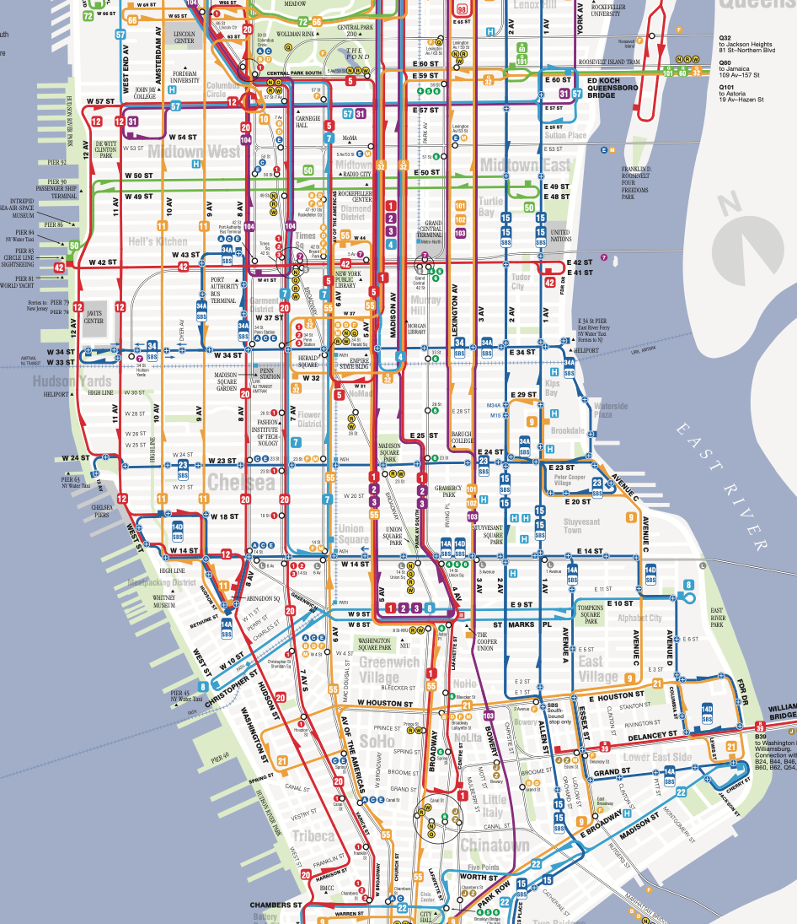
Recomendations

Slide 8
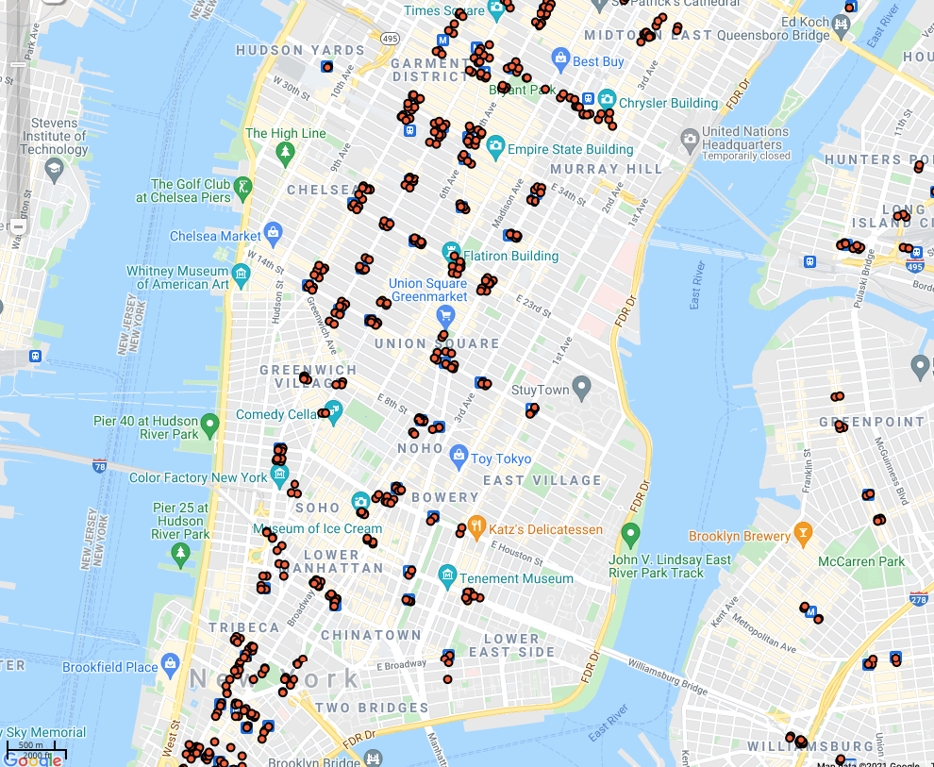

Slide 9
Further Analysis to Improve Outcomes
Entries/Exits Times
Day/Months
Add Census Data

Slide 10
Appendix
https://www.nytimes.com/2020/10/13/nyregion/big-tech-nyc-office-space.html
https://finance.yahoo.com/news/why-americas-tech-giants-are-flocking-to-one-part-of-nyc-130830663.html
https://data.cityofnewyork.us/Transportation/Subway-Entrances/drex-xx56

